Slide 1
H omework
Read the following slides on Ethical and Social Issues in Information Systems
Come prepared to class to answer some questions

Slide 2
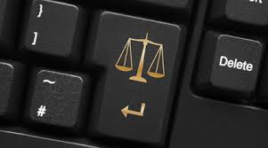
Chapter 4
Organizations, Management, and the Networked Enterprise
Ethical and Social Issues in Information Systems
MFIS
Lisa Murphy
Notes:
2

Slide 3

Learning Objectives
To gain an understanding of the following:
What ethical, social, and political issues are raised by information systems?
What specific principles for conduct can be used to guide ethical decisions?
Why do contemporary information systems technology and the Internet pose challenges to the protection of individual privacy and intellectual property?
How have information systems affected everyday life?

Slide 4
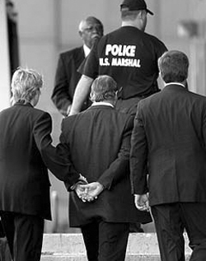
Understanding Ethical and Social Issues Related to Systems
Past five years: One of the most ethically challenged periods in history
Lapses in management ethical and business judgment in a broad spectrum of industries
Enron, WorldCom, Parmalat, etc.
Sub-prime loans and the failure of risk analysis: CitiBank and Societe Generale
Information systems instrumental in many recent frauds
Stiffer sentencing guidelines, obstruction charges against firms, mean individual managers must take greater responsibility regarding ethical and legal conduct
“Perp” Walk!

Slide 5
Failed Ethical Judgement by Managers

Slide 6
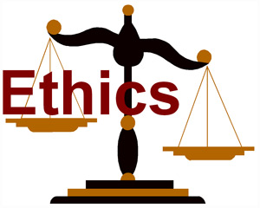
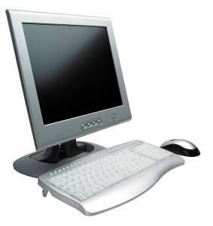
Ethics
Ethics
Principles of right and wrong that individuals, acting as free moral agents, use to make choices to guide their behavior
Information systems and ethics
Information systems raise new ethical questions because they create opportunities for:
Intense social change, threatening existing distributions of power, money, rights, and obligations
New kinds of crime

Slide 7

A model for thinking about Ethical, Social, and Political issues
Society as a calm pond
IT as a rock dropped in pond, creating ripples of new situations not covered by old rules
Social and political institutions cannot respond overnight to these ripples — it may take years to develop etiquette, expectations, laws
Requires understanding of ethics to make choices in legally gray areas

Slide 8
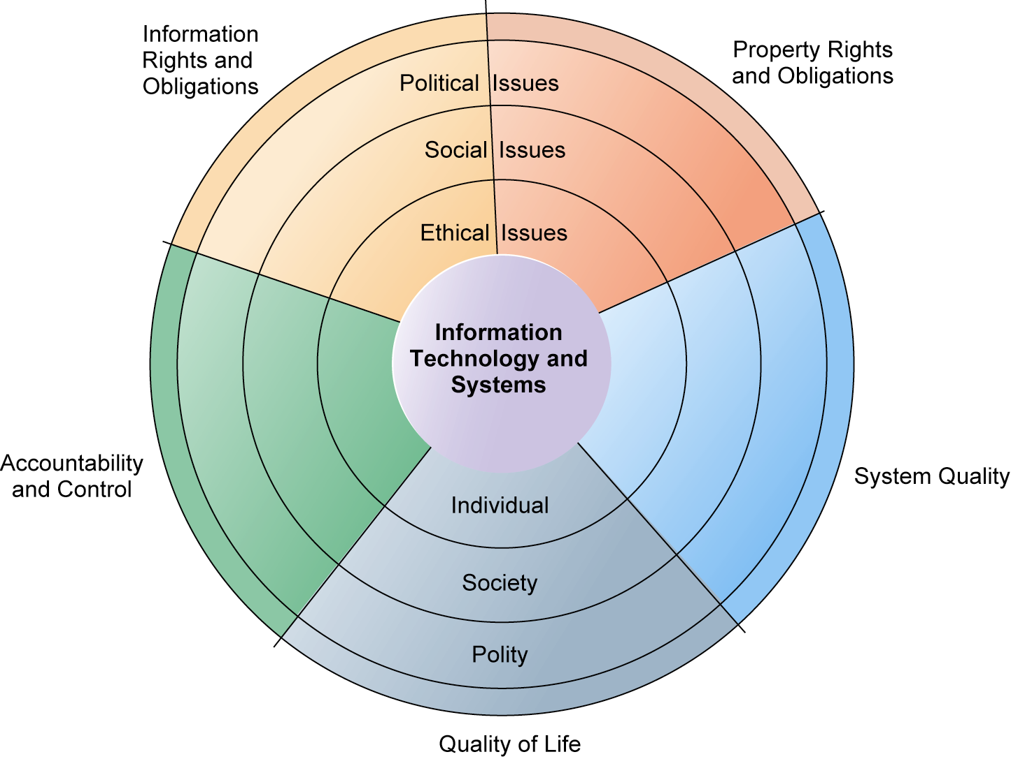
The Relationship between Ethical, Social, and Political issues in an Information society

Slide 9

The Relationship Between Ethical, Social, and Political Issues in an Information Society
The introduction of new information technology has a ripple effect, raising new ethical, social, and political issues that must be dealt with on the individual, social, and political levels
These issues have five moral dimensions:
Information rights and obligations
Property rights and obligations
System quality
Quality of life
Accountability and control

Slide 10
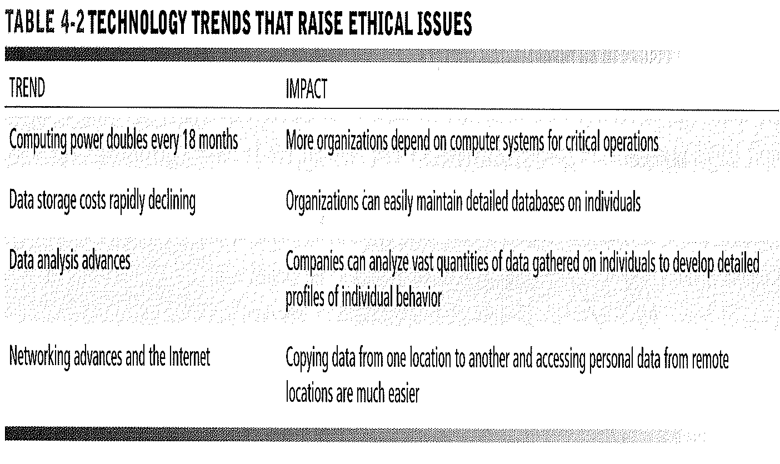
Technology Trends

Slide 11
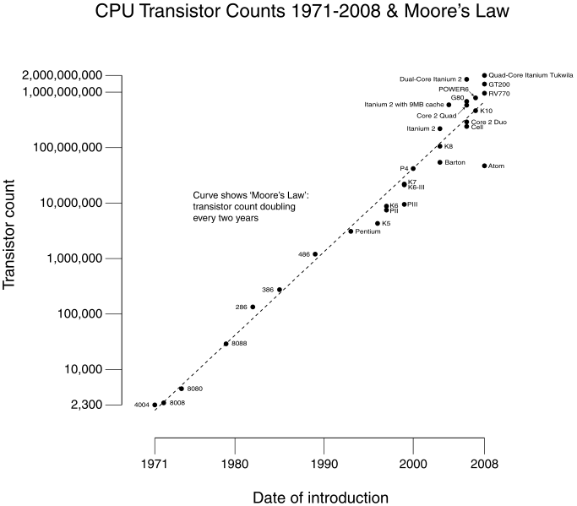
Four key technology trends that raise ethical issues (1)
Computing power doubles every 18 months (Moore’s Law)
Increased reliance on, and vulnerability to, computer systems

Slide 12
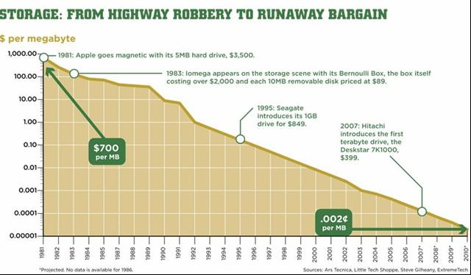
Four key technology trends that raise ethical issues (2)
Data storage costs rapidly declining
Multiplying databases on individuals

Slide 13
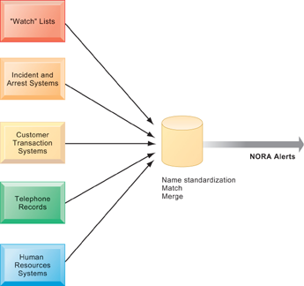
Four key technology trends that raise ethical issues (3)
Data analysis advances
Greater ability to find detailed personal information on individuals
Profiling and nonobvious relationship awareness (NORA)

Slide 14
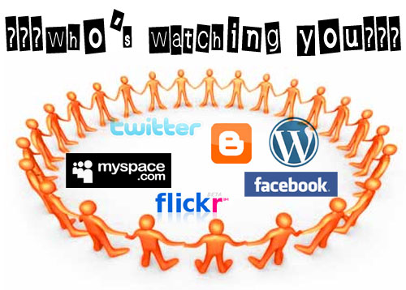
Four key technology trends that raise ethical issues (4)
Networking advances and the Internet
Enables moving and accessing large quantities of personal data

Slide 15
Basic concepts form the underpinning of an ethical analysis of information systems and those who manage them
Responsibility: Accepting the potential costs, duties, and obligations for decisions
Accountability: Mechanisms for identifying responsible parties
Liability: Permits individuals (and firms) to recover damages done to them
Due process: Laws are well known and understood, with an ability to appeal to higher authorities

Slide 16
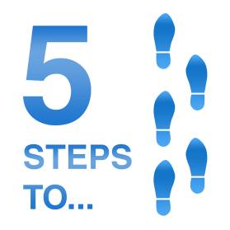
Ethical analysis: A five-step process
Identify and clearly describe the facts
Define the conflict or dilemma and identify the higher-order values involved
Identify the stakeholders
Identify the options that you can reasonably take
Identify the potential consequences of your options

Slide 17
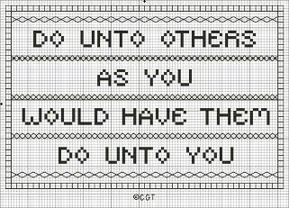
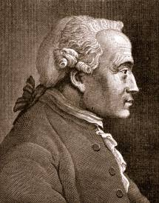

Candidate Ethical Principles
Golden Rule
Do unto others as you would have them do unto you
Immanuel Kant’s Categorical Imperative
If an action is not right for everyone to take, it is not right for anyone
Descartes' rule of change
If an action cannot be taken repeatedly, it is not right to take at all

Slide 18



Candidate Ethical Principles (cont.)
Utilitarian Principle
Take the action that achieves the higher or greater value
Risk Aversion Principle
Take the action that produces the least harm or least potential cost
Ethical “no free lunch” rule
Assume that virtually all tangible and intangible objects are owned by someone unless there is a specific declaration otherwise

Slide 19

Professional codes of conduct
Promulgated by associations of professionals
E.g. AMA, ABA, AITP, ACM
Promises by professions to regulate themselves in the general interest of society
As an ACM member I will ....
Contribute to society and human well-being
Avoid harm to others
Be honest and trustworthy
Be fair and take action not to discriminate
Honour property rights including copyrights and patent
Give proper credit for intellectual property
Respect the privacy of others
Honour confidentiality
GENERAL MORAL IMPERATIVES
http://www.acm.org/about/code-of-ethics

Slide 20
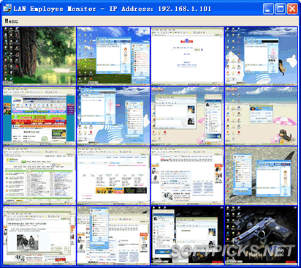
Real-world ethical dilemmas
One set of interests pitted against another
EG - Right of company to maximize productivity of workers vs. workers right to use Internet for short personal tasks
http://www.softpicks.net/software/LAN-Employee-Monitor-40989.htm

Slide 21

The Moral Dimensions of Information Systems
Information rights and obligations
Privacy
Claim of individuals to be left alone, free from surveillance or interference from other individuals, organizations, or the state.
Ability to control information about yourself
In U.S., privacy protected by:
First Amendment (freedom of speech)
Fourth Amendment (unreasonable search and seizure)
Additional federal statues
Privacy Act of 1974

Slide 22

Ireland - Data Protection Rules
As a Data Controller, you have certain key responsibilities in relation to the information which you keep on computer or in a structured manual file about individuals
You must ...
Obtain and process the information fairly
Keep it only for one or more specified and lawful purposes
Process it only in ways compatible with the purposes for which it was given to you initially
Keep it safe and secure
Keep it accurate and up-to-date
Ensure that it is adequate, relevant and not excessive
Retain it no longer than is necessary for the specified purpose or purposes
Give a copy of his/her personal data to any individual, on request.

Slide 23
Management Information Systems Chapter 4: Ethical and Social Issues in Information Systems
Fair information practices:
Set of principles governing the collection and use of information
Basis of most U.S. and European privacy laws
Based on mutuality of interest between record holder and individual
Restated and extended by FTC in 1998 to provide guidelines for protecting online privacy
Used to drive changes in privacy legislation
COPPA
Gramm-Leach-Bliley Act
HIPAA
The Moral Dimensions of Information Systems

Slide 24
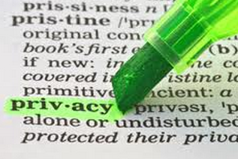
Fair Information Practices
Notice/awareness (core principle):
Web sites must disclose practices before collecting data
Choice/consent (core principle):
Consumers must be able to choose how information is used for secondary purposes
Access/participation:
Consumers must be able to review, contest accuracy of personal data
Security:
Data collectors must take steps to ensure accuracy, security of personal data
Enforcement:
Must be mechanism to enforce FIP principles

Slide 25

European Directive on Data Protection
Requires companies to inform people when they collect information about them and disclose how it will be stored and used.
Requires informed consent of customer (not true in the U.S.)
EU member nations cannot transfer personal data to countries without similar privacy protection (e.g. U.S.)
U.S. businesses use safe harbor framework
Self-regulating policy and enforcement that meets objectives of government legislation but does not involve government regulation or enforcement.
http://ec.europa.eu/justice_home/fsj/privacy/

Slide 26
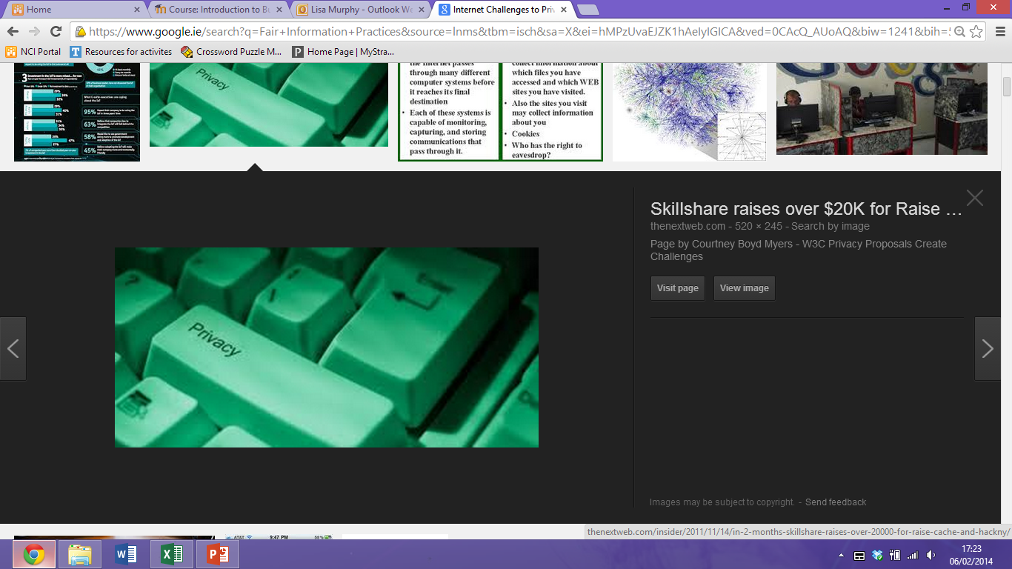
Internet Challenges to Privacy
Cookies
Tiny files downloaded by Web site to visitor’s hard drive
Identify visitor’s browser and track visits to site
Allow Web sites to develop profiles on visitors
Web bugs
Tiny graphics embedded in e-mail messages and Web pages
Designed to monitor who is reading a message and transmitting that information to another computer on the Internet
Spyware
Surreptitiously installed on user’s computer
May transmit user’s keystrokes or display unwanted ads

Slide 27
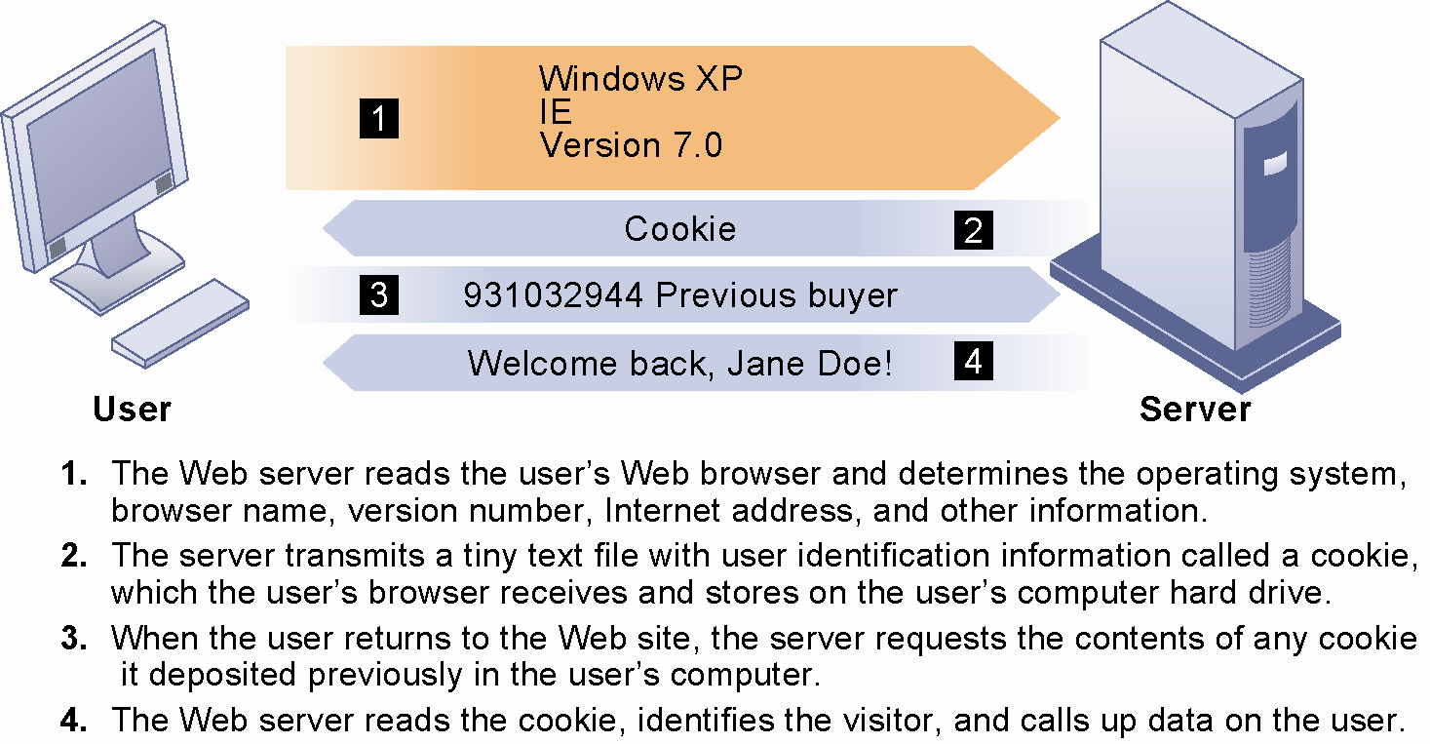
How Cookies Identify Web Visitors
Cookies are written by a Web site on a visitor’s hard drive. When the visitor returns to that Web site, the Web server requests the ID number from the cookie and uses it to access the data stored by that server on that visitor. The Web site can then use these data to display personalized information.

Slide 28
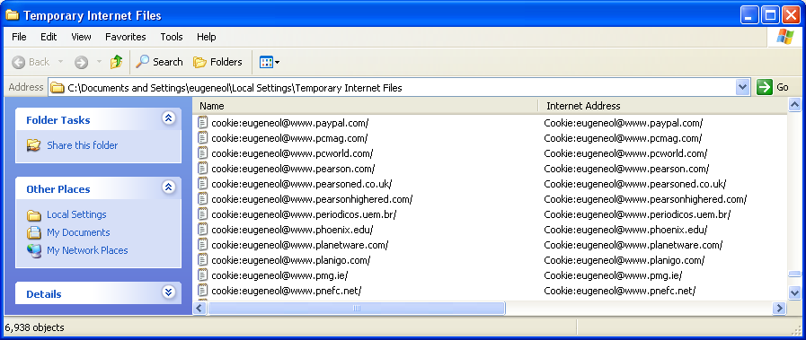
Cookies
Selection of cookies…

Slide 29
Use of Information
U.S. allows businesses to gather transaction information and use this for other marketing purposes
Online industry promotes self-regulation over privacy legislation
Self regulation has proven highly variable
Statements of information use are quite different
Some firms offer opt-out selection boxes
Online “seals” of privacy principles
Most Web sites do not have any privacy policies
Many online privacy policies do not protect customer privacy, but rather protect the firm from lawsuits

Slide 30
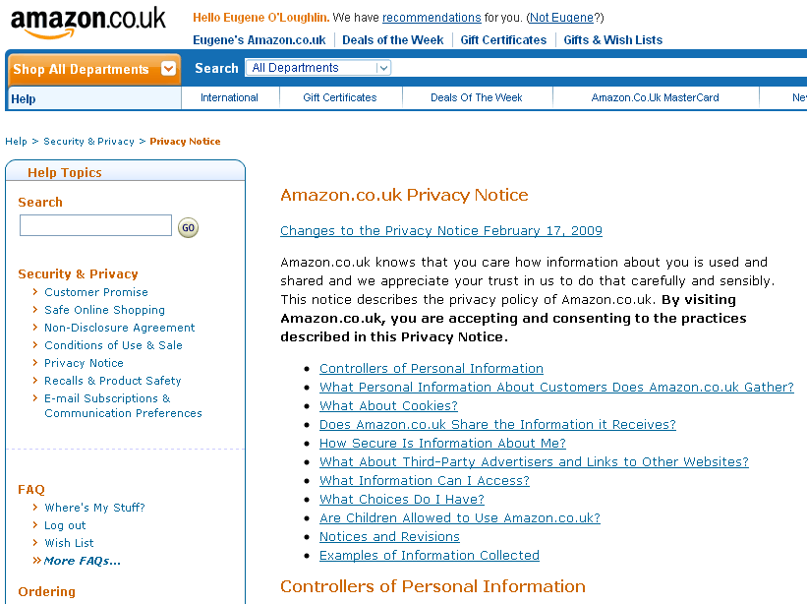
Amazon.co.uk Privacy Notice

Slide 31

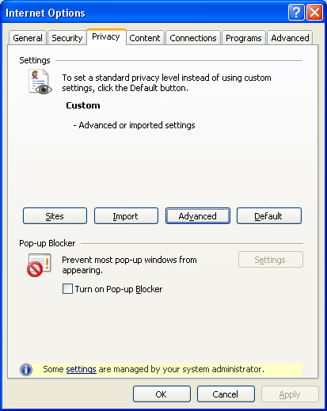
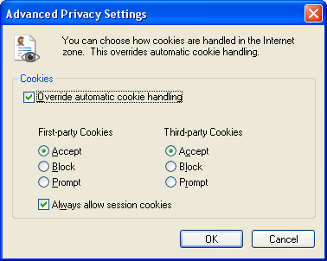
Technical solutions
The Platform for Privacy Preferences (P3P)
Allows Web sites to communicate privacy policies to visitor’s Web browser – user
User specifies privacy levels desired in browser settings
E.g., “medium” level accepts cookies from first-party host sites that have opt-in or opt-out policies but rejects third-party cookies that use personally identifiable information without an opt-in policy

Slide 32
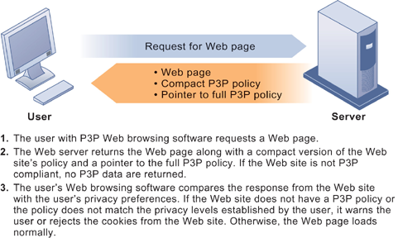
The P3P Standard
P3P enables Web sites to translate their privacy policies into a standard format that can be read by the user’s Web browser software. The user’s Web browser software evaluates the Web site’s privacy policy to determine whether it is compatible with the user’s privacy preferences.

Slide 33


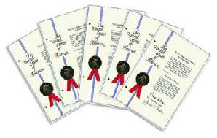
Property Rights: Intellectual Property
Intellectual property
Intangible property of any kind created by individuals or corporations
Three ways that intellectual property is protected
Trade secret: Intellectual work or product belonging to business, not in the public domain
Copyright: Statutory grant protecting intellectual property from being copied for the life of the author, plus 70 years
Patents: Grants creator of invention an exclusive monopoly on ideas behind invention for 20 years

Slide 34
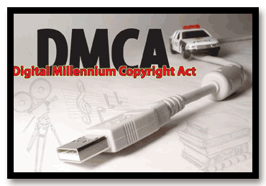
Challenges to Intellectual Property Rights
Digital media different from physical media (e.g. books)
Ease of replication
Ease of transmission (networks, Internet)
Difficulty in classifying software
Compactness
Difficulties in establishing uniqueness
Digital Millenium Copyright Act (DMCA)
Makes it illegal to circumvent technology-based protections of copyrighted materials

Slide 35
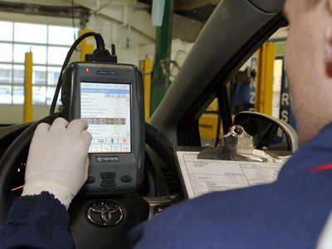
Accountability, Liability, Control
Computer-related liability problems
If software fails, who is responsible?
If seen as a part of a machine that injures or harms, software producer and operator may be liable
If seen as similar to a book, difficult to hold software author/publisher responsible
What should liability be if software is seen as service?
Would this be similar to telephone systems not being liable for transmitted messages (so-called “common carriers”)
Toyota Accelerator Pedal Recall Work

Slide 36
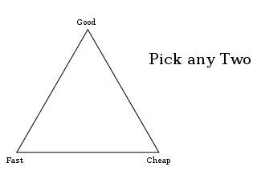
System Quality: Data Quality and System Errors
What is an acceptable, technologically feasible level of system quality?
Flawless software is economically unfeasible
Is “zero defects” possible?
Three principal sources of poor system performance:
Software bugs, errors
Hardware or facility failures
Poor input data quality (most common source of business system failure)

Slide 37

Quality of Life
Negative social consequences of systems
Balancing power: Although computing power is decentralizing, key decision-making power remains centralized
Rapidity of change: Businesses may not have enough time to respond to global competition
Maintaining boundaries: Computing and Internet use lengthens the work-day, infringes on family, personal time
Dependence and vulnerability: Public and private organizations ever more dependent on computer systems

Slide 38

Computer crime and abuse
Computer crime: Commission of illegal acts through use of compute or against a computer system – computer may be object or instrument of crime
Computer abuse: Unethical acts, not illegal
Spam: High costs for businesses in dealing with spam
Employment: Reengineering work resulting in lost jobs
Equity and access – the digital divide: Certain ethnic and income groups are less likely to have computers or Internet access

Slide 39
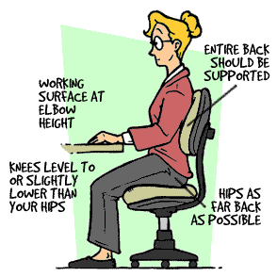
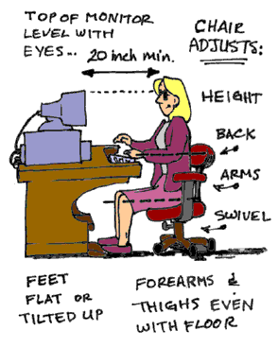
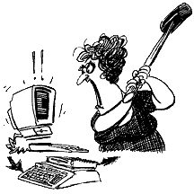
Health risks
Repetitive stress injury (RSI)
Largest source is computer keyboards
Carpal Tunnel Syndrome (CTS)
Computer vision syndrome (CVS)
Technostress
Role of radiation, screen emissions, low-level electromagnetic fields

Slide 40

RECAP
To gain an understanding of the following:
What ethical, social, and political issues are raised by information systems?
What specific principles for conduct can be used to guide ethical decisions?
Why do contemporary information systems technology and the Internet pose challenges to the protection of individual privacy and intellectual property?
How have information systems affected everyday life?

